Slide 1
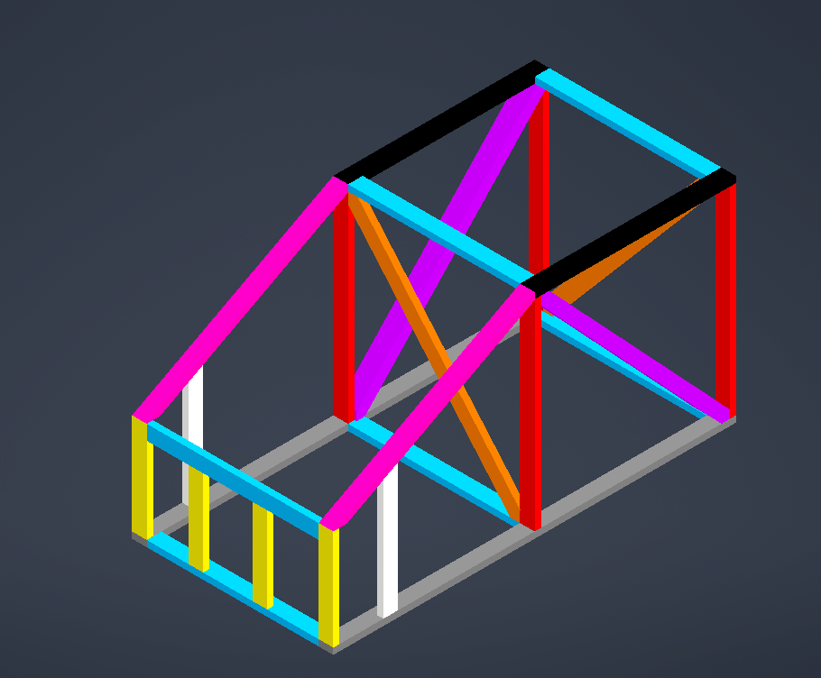

Front Foot Instructions (x2)

Slide 2
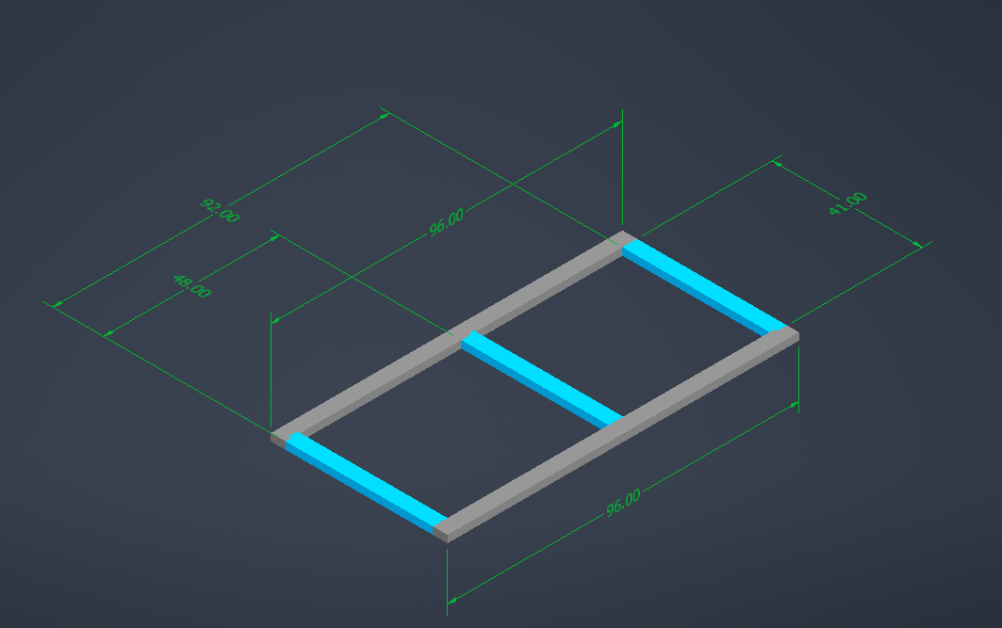
Example Instructions
(2) 2x4x96 (8') (GRAY)
(2) 2x4x96 (3'5'') (BLUE)
First number in parentheses tells you how many board you need to cut, the 2x4xVV value is the length of board, the next value is the length of the cut, and the final part is the color it is in the image. Additional instructions will be provided throughout.

Slide 3
Cut List
(10) 2x4x8
  (2 boards) → (1) 96” per board
  (3 boards) → (2) 48” per board
  (3 boards) → (2) 41” per board
  (2 boards) → (1) 24” + (1) S66
(3) 2x4x10
  (1 board) → (2) S55
  (2 boards) →(1) 20.5” + (1) S31 + (1) S66
  Label all boards as you cut and keep track!

Slide 4
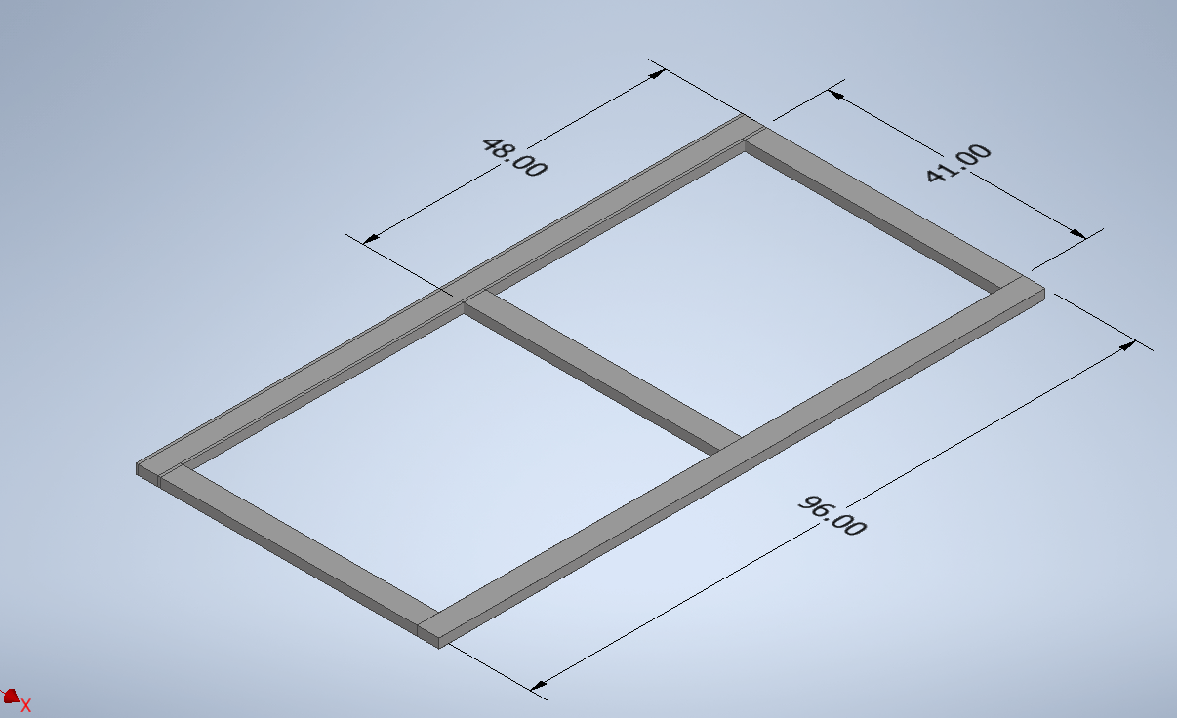
Base
(2) 96"
(3) 41''

Slide 5
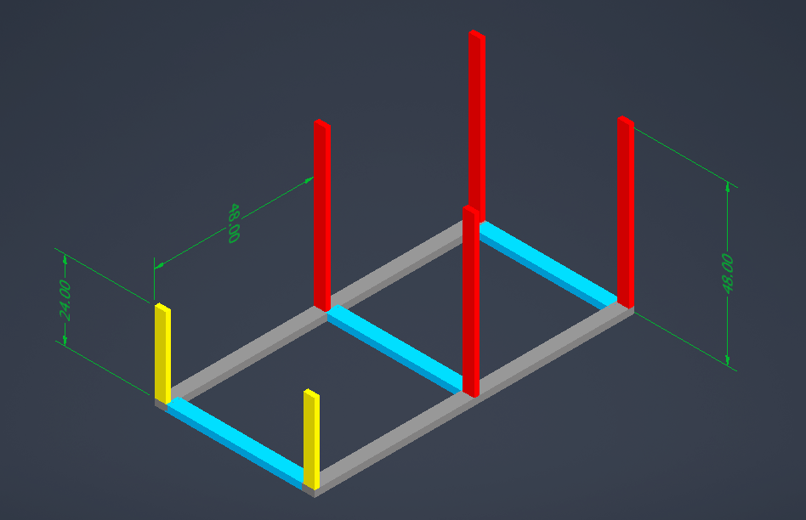
Supports
(4) 48”
(2) 24”

Slide 6
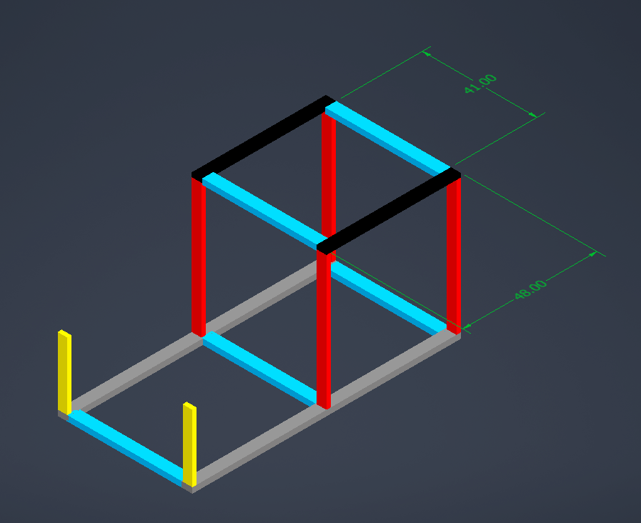
Roof
(2) 48”
(2) 41”

Slide 7
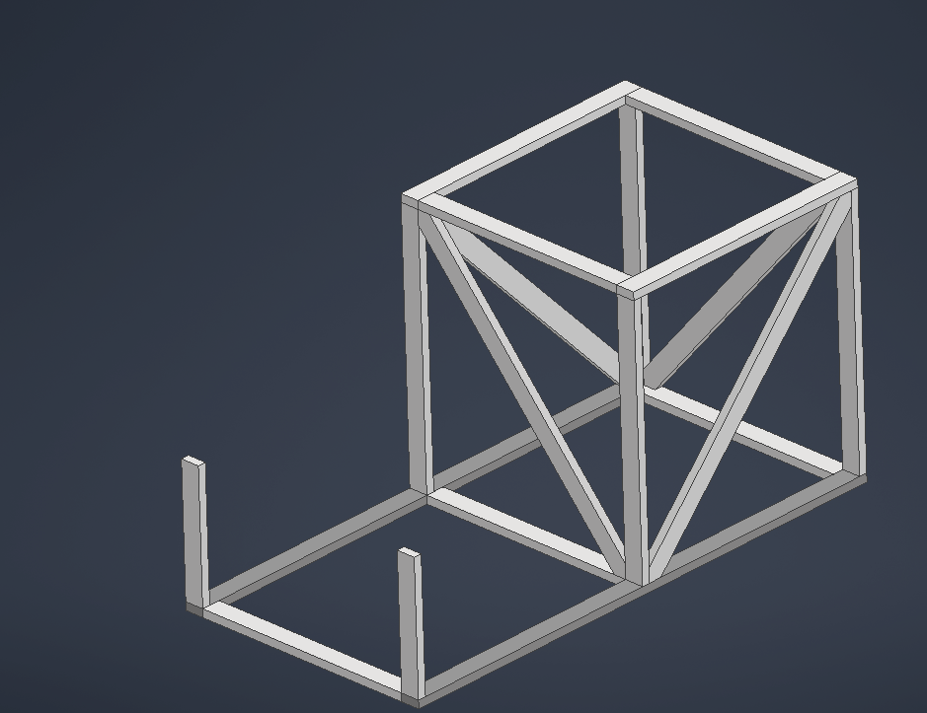
Inner Diagonals
(4) S66
(pictures are a bit out of order but do these box diagonals before adding the toe)

Slide 8
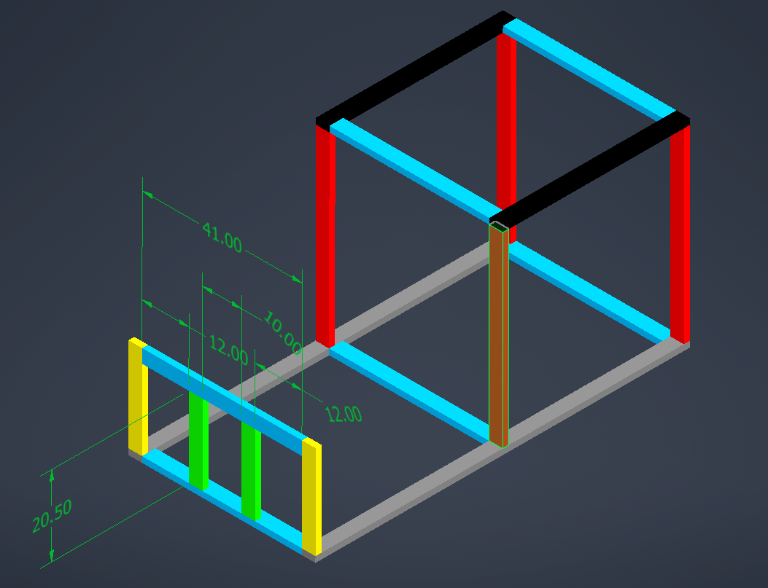
Claw area
(2) 20.5”
(1) 41”

Slide 9
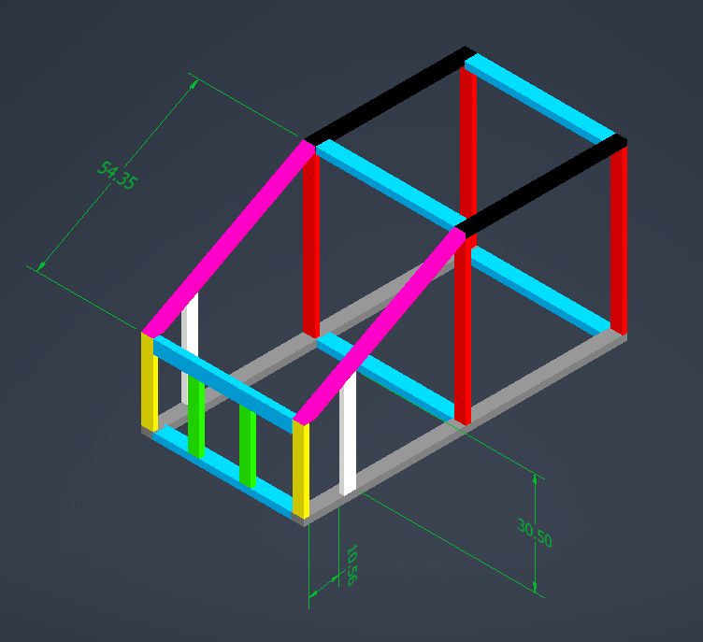
Front Diagonal and Support
(2) S55
(2) S31

Slide 10
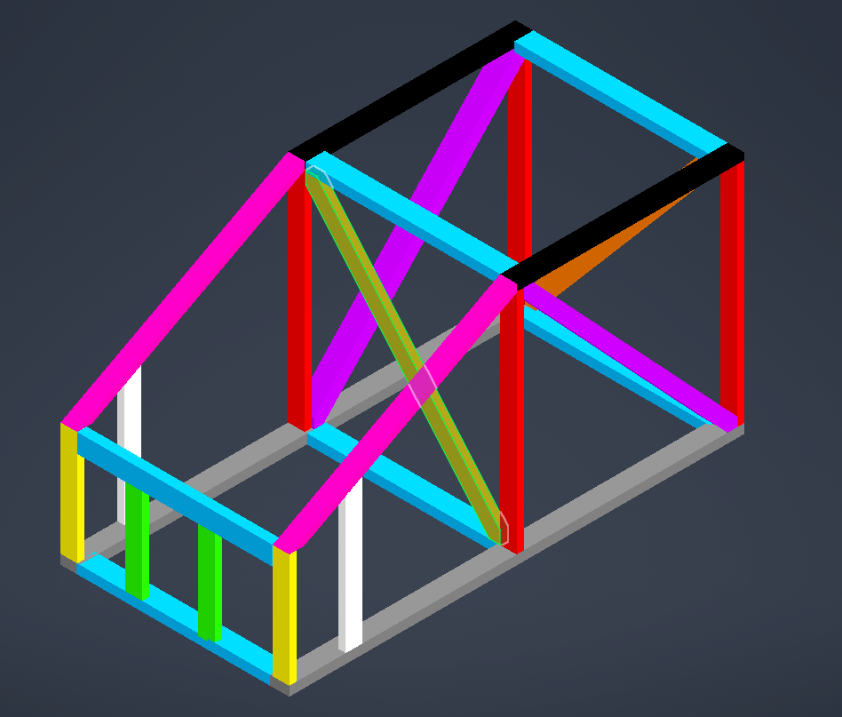
CONGRATS!!
Now the other Front Foot!

